Slide 1


Slide 2
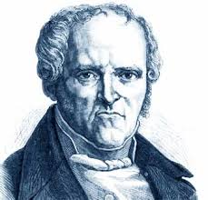
HISTORY OF FEMINISM
Charles Fourier(1837) is credited with having coined the word feminism.
Dependence:
Historic moment
Culture
Country
Causes
Goals

Slide 3
Why the Feminist Movement?
“There is a need to address radically the additional layers of discrimination women experience because of class, race, sexuality, disability, and age, and also the heightened impact on women and children of war, poverty and environmental degradation.”

Slide 4

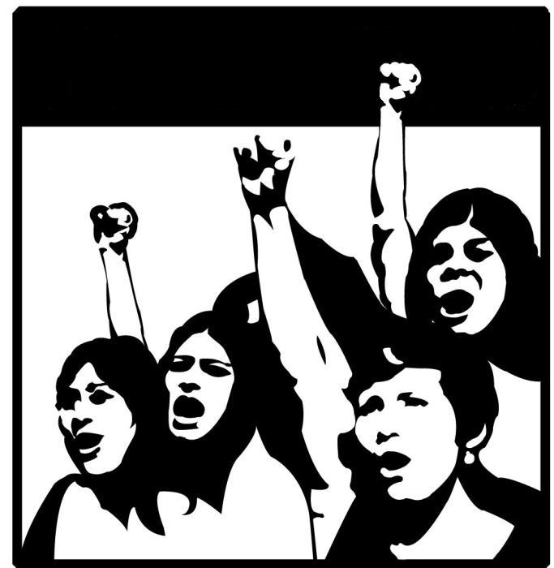
Waves

Slide 5
First Wave Feminism

Slide 6
Most Important incidents
Russia: In 1913 women observed their first International Women's Day on the last Sunday in February. Following discussions, International Women's Day was transferred to 8 March and this day has remained the global date for International Women's Day ever since.
England: In 1918 Marie Stopes, who believed in equality in marriage and the importance of women's sexual desire, published Married Love, a sex manual that, according to a survey of American academics in 1935, was one of the 25 most influential books of the previous 50 years.
Germany: in 1919 granted women the right to vote
England 1919- Nancy Astor became the first woman to take her seat in the House of Commons.
China: The first female students were accepted in Peking University, soon followed by universities all over China.

Slide 7
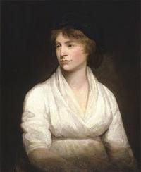
The First Wave
This term refers to the first concerted movement working for the reform of women's social and legal inequalities in the nineteenth century.
The term was coined in 1895.
Although individual feminists such as Mary Wollstonecraft and J.S. MIll had already argued against the injustices suffered by women, it was not until the 1850s that something like an organized feminist movement evolved in Britain.
Its headquarters was at Langham Place in London, where a group of middle-class women, led by Barbara Bodichon (1827-91) and Bessie Rayner Parkes (1829-1925), met to discuss topical issues and publish the English Woman's Journal (1858-64).

Slide 8
First Wave Contd…
19th century and early 20th century UK & US
This version of feminism continued to exist into the 1950s and 1960s.
Worked for improving working conditions and educational rights for women, girls and the plight of intelligent middle-class single women.
Liberal Feminism is the main Proponent
The emphasis of liberal feminism is on inequality between men and women in the public sphere of life - employment, education and politics.

Slide 9
First Wave Contd…
Liberal feminists champion legal and political equality with men.
Mary Wollstonecraft argued that women should be entitled to the same rights.
According to this philosophy, society itself does not need a major overhaul, but rather laws need to be changed.
Liberal feminists focus on individual empowerment.
In the United States and much of the Western world, liberal feminism is the most mainstream form of feminism.

Slide 10
Achievements
First Wave Feminists largely responded to specific injustices they had themselves experienced.
The opening of higher education for women;
Reform of the girls' secondary-school system, including participation in formal national examinations:
The widening of access to the professions, especially medicine;
Won improved rights for women in marriage.
Recognized in the Married Women's Property Act of 1870;

Slide 11
Achievements Cont…..
Its biggest achievement was winning some political power.
In the UK the Suffragettes and Suffragists campaigned for the women’s vote.
In 1918, women over thirty who owned property won the vote and in 1928 it was extended to all women over twenty-one.
First Wave Feminists failed, however, to secure the women's vote. – This fell to the work of the Suffragettes ...
And some improvement in divorced and separated women's child custody rights.
Active until the First World War,

Slide 12
Second Wave Feminism

Slide 13
Most Important Incidents
1966 Twenty-eight women, among them Betty Friedan, founded the National Organization for Women (NOW).
1969 The American radical organization Redstockings organized.
1973 The American National Black Feminist Organization was formed
1977 the Canadian Human Rights Act was passed, prohibiting discrimination based on characteristics including sex and sexual orientation, and requiring "equal pay for work of equal value
1980 The second wave began in the 1980s in Turkey and in Israel.

Slide 14
The Second Wave
A feminist movement beginning in the early 1960s and continuing to the present, and it coexists with the First Wave.
The term 'Second Wave' was coined by Marsha Lear, and refers to the increase in feminist activity which occurred in America, Britain, and Europe from the sixties onwards.
It extended the fight beyond political rights to education, work and the home.
In ‘The Feminine Mystique’ (1963) Betty Freidan argues women were unhappy because of the feminine mystique. She said this was a damaging ideal of femininity which she called, “The Happy Housewife” and it restricted women to the role of housewife and mother, giving up on work and education.

Slide 15
The Second Wave Contd…
In America, second wave feminism rose out of the Civil Rights and anti-war movements in which women, disillusioned with their second-class status even in the activist environment of student politics, began to band together to contend against discrimination.
The tactics employed by Second Wave Feminists varied from well publicised activities, such as the protest against the Miss America beauty contest in 1968, to the establishment of small consciousness-raising groups.

Slide 16
The Second Wave Contd…
However, it was obvious early on that the movement was not a unified one, with differences emerging between black feminism, liberal feminism, social feminism, etc.
Second Wave Feminism in Britain was also multiple in focus, although it was based more strongly in working-class socialism, as demonstrated by the strike of women workers at the Ford car plant for equal pay in 1968.
The slogan 'the personal is political' sums up the way in which Second Wave Feminism did not just strive to extend the range of social opportunities open to women, but also, through intervention within the spheres of reproduction, sexuality and cultural representation, to change their domestic and private lives.

Slide 17

The Second Wave Contd…
Second Wave Feminism did not just make an impact upon western societies, but has also continued to inspire the struggle for women's rights across the world.
Betty

Slide 18
The Female Eunuch – Germaine Greer (1970)
Greer argued women are ‘castrated’, the eunuch of the title, by society. In particular she attacked the nuclear family, romantic role and the limits on women’s sexuality. She argued that gender roles were not natural but learned. They conditioned girls to conform to a very restrictive femininity. The book has been criticised for not offering any realistic solutions to women’s oppression, because it proposed action by individual women rather than organised political action.

Slide 19
Third Wave Feminism

Slide 20
The Most Important Incidents
1994: The Gender Equity in Education Act became law in the U.S. It banned sex-role stereotyping and gender discrimination in the classroom
1994: The Violence Against Women Act became law in the U.S
1995: The Fourth World Conference on Women was held in China
2007: The Gender Equality Act 2006 came into effect in the United Kingdom
2008: Norway requires all companies to have at least forty percent women on their boards

Slide 21
The Third Wave
1990s – present
Widened the feminist movement and its ideas beyond middle class, white women, addressing the different disadvantages women experience because of, for example their race, ethnicity and class.
When Rebecca Walker (daughter of author Alice Walker and) published an article in Ms. Magazine entitled "I Am The Third Wave," it drew a surprising response.

Slide 22
The Third Wave Contd…
Young women from all over wrote letters informing the magazine of the activist work they were quietly engaged in and encouraging older feminists and leaders of the women's movement not to write them off.
The front page of the Third Wave Foundation web site explains that the organization strives to combat inequalities that [women] face as a result of [their] age, gender, race, sexual orientation, economic status or level of education. By empowering young women, Third Wave feminists would argue they were building a lasting foundation for social activism.

Slide 23
The Third Wave Contd…
Began as a response to perceived failures of the second wave and to the backlash against initiatives and movements created by the second wave.
Third wave feminist argued , that second wave has over-emphasize the experiences of upper middle-class white women.
Third Wave feminism celebrates the construction of individual identities in a complex, postmodern world.
Third Wave feminism is focused more on personal empowerment as a starting place for social change.
Some argue that seeing the history of feminism in just these three waves can ignore the fight for equal rights and the end to discrimination by women outside the large feminist movements in the UK and US, including working class women and black and ethnic minority women.

Slide 24
Waves of Feminism VS Theories
First wave of feminism | Second Wave of Feminism | Third Wave of Feminism
Liberal Feminism | Radical feminism 2.Marxist feminism 3. Socialist feminism 4.Islamic feminism | 1.Black feminism 2.Post modern feminism 3.Psychoanalytical feminism
Individual Liberal and Postmodern | Class Analysis Marxist, Socialist Radicals

Slide 25
FEMINISM IN PAKISTAN
Many of us think that feminism and the movement are recent phenomena in Pakistan.
Religion
State
Social responsibility
Culture
History

Slide 26
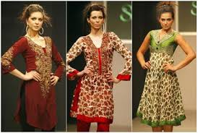


FEMINISM IN PAKISTAN
Role Of Media
& Impact Of West
The West Didn’t Export It To Us.
Weakness of our society
It is not a ‘yahoodiyoon ki saazish’.
If a guy earns for his family.

Slide 27
FEMINISTS OF PAKISTAN
Asma Jahangir
Fareeda Kokikhel Afridi
Kishwar Naheed
Women’s Rights Activitist.
Nobel Peace Prize as part of the 1000 Women for Peace project.
WAF (Women’s Action Forum).
Pashtun Feminist.
SAWERA (Society for Appraisal and Women Empowerment in Rural Areas).
Urdu Feminist Poet.
Sitara-e-Imtiaz.
Hawwa (Eve).

Slide 28
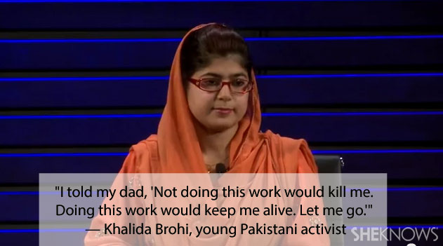
FEMINISM IN PAKISTAN

Slide 29
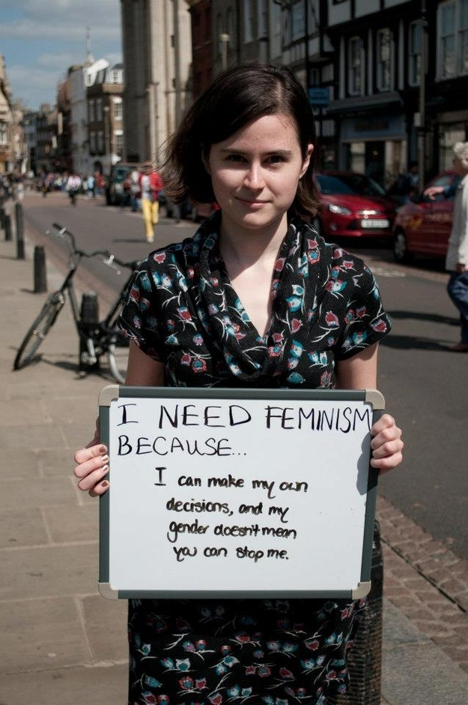
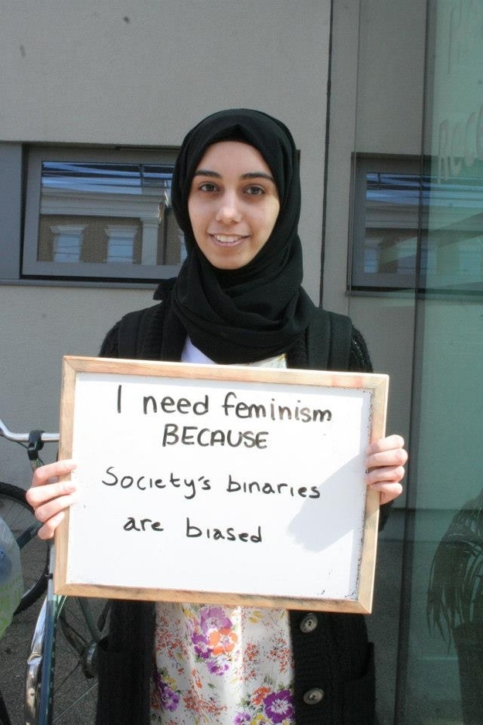
WHY WE STILL NEED FEMINISM

Slide 30
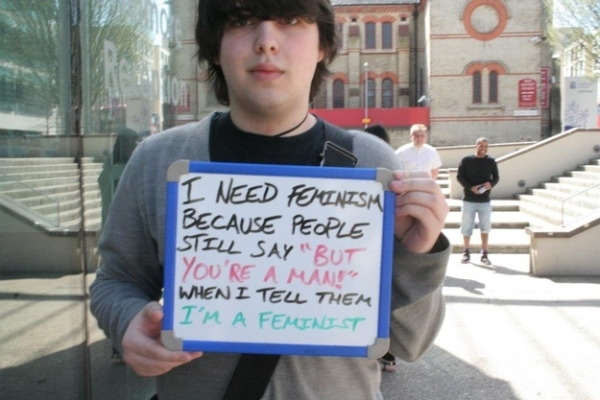

Slide 31
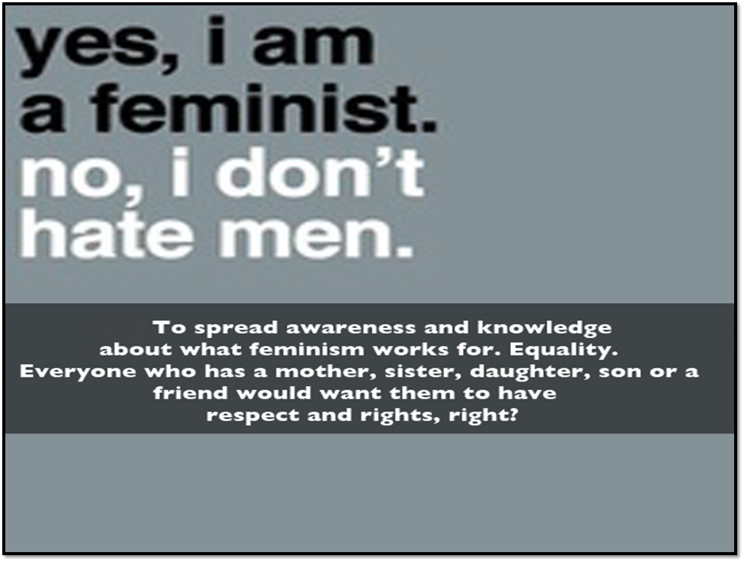

Slide 32
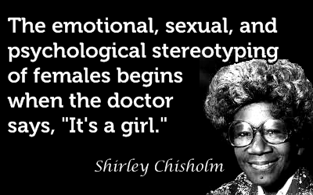

Slide 33


Slide 34
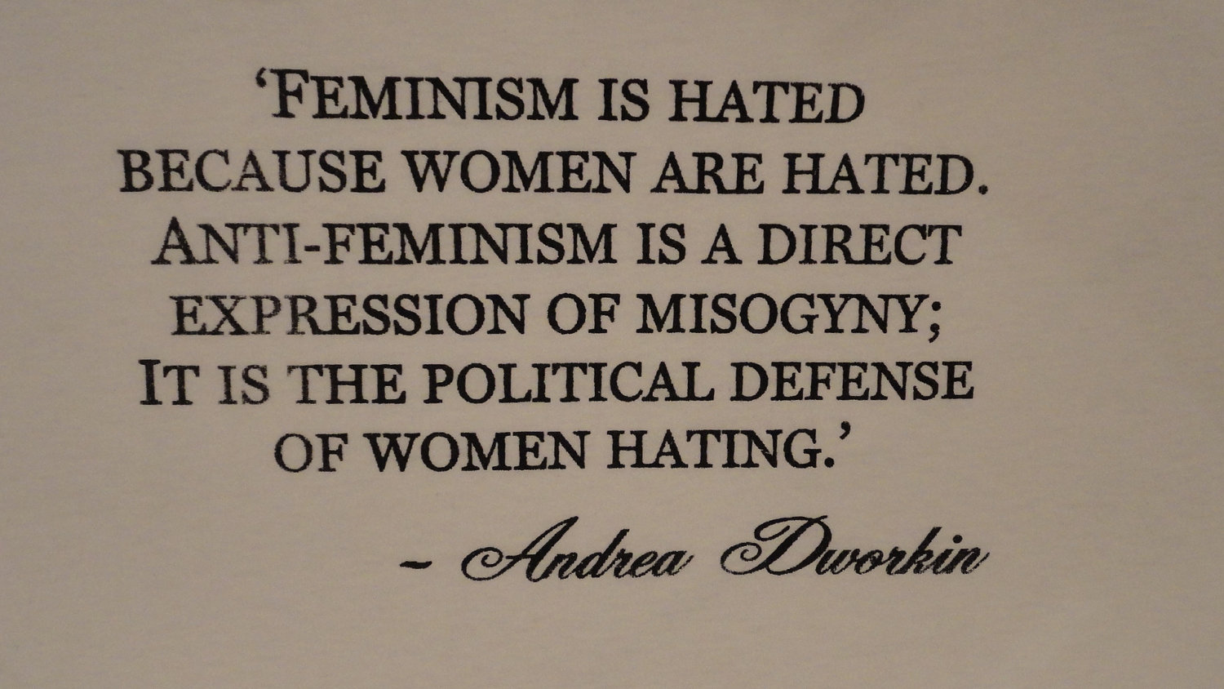

Slide 35
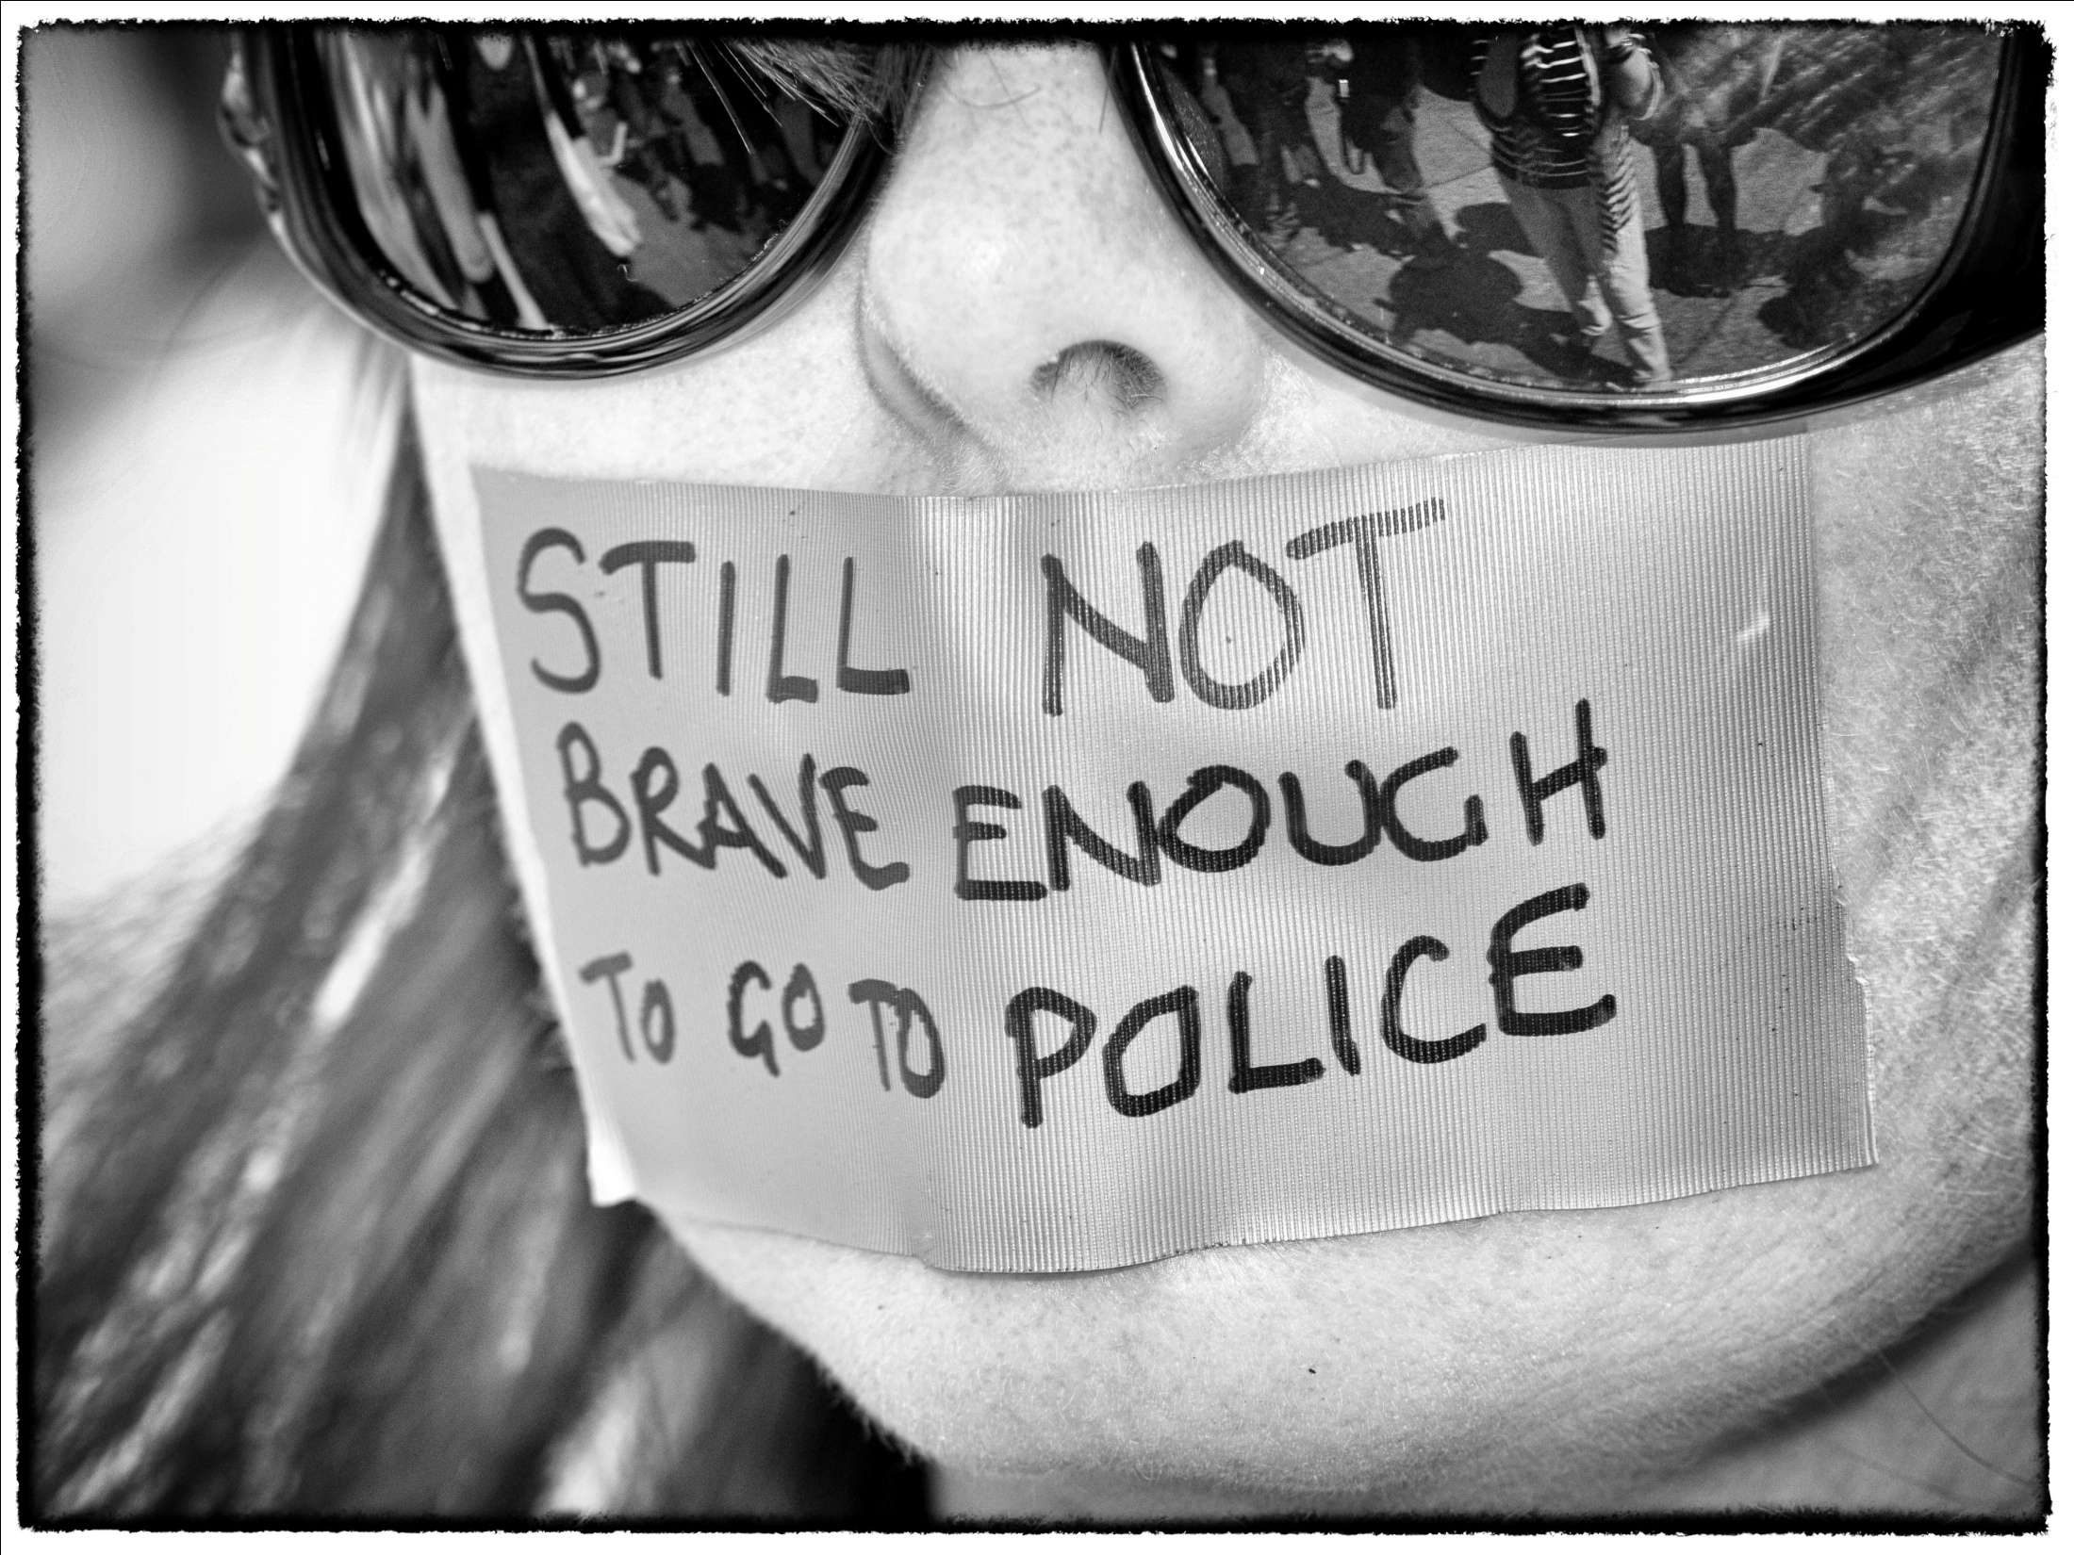

Slide 36
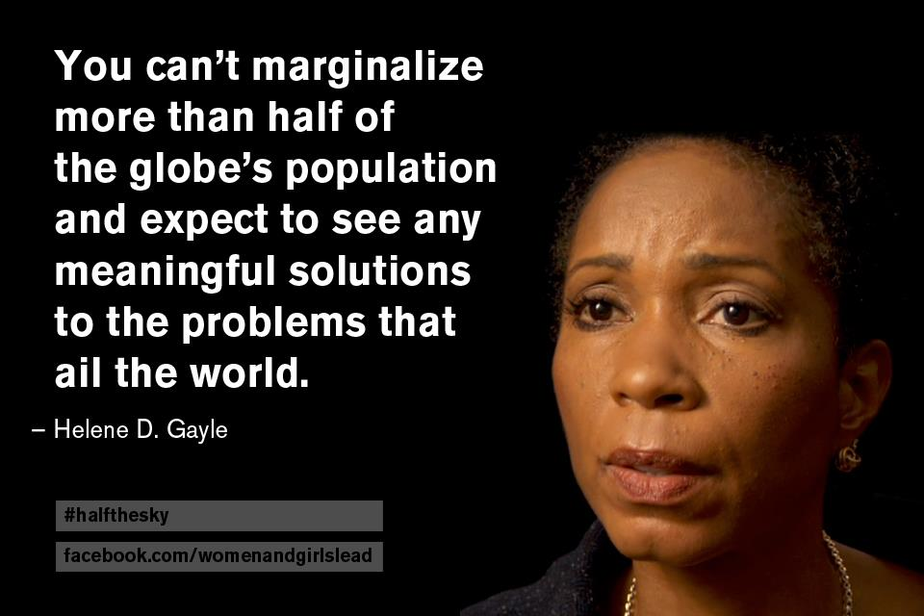

Slide 37
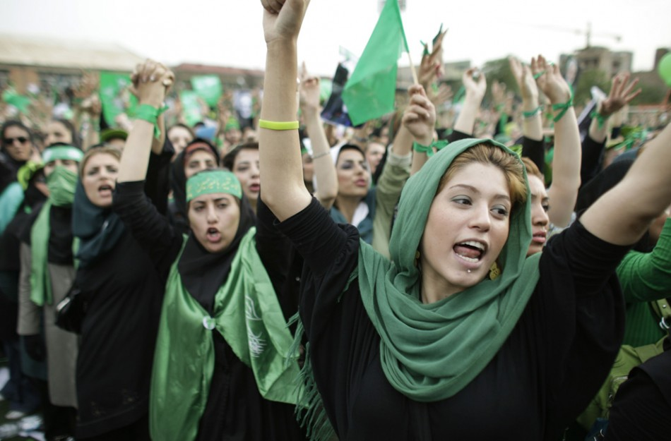

Slide 38
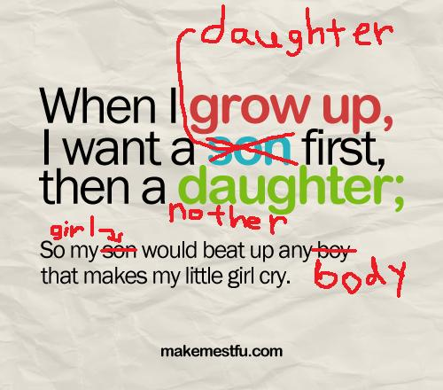

Slide 39


